Slide 1
Science
Name:
School Affiliation:

Slide 2
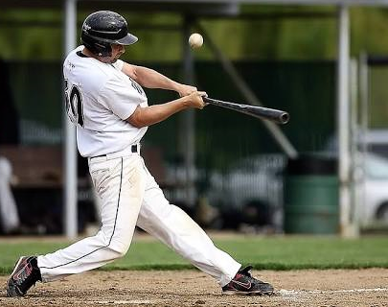
Covered Concepts:
Relationship between impulse momentum theorem and Newton’s second law.
J = ∆p
J = Impulse
∆p = Change in momentum

Slide 3
Observed: the amount of force applied by the baseball player translates to the change in momentum of the baseball.
Explanation: When a force acts on a body in a given time, an impulse is generated. For instance, in the above case, when a baseball is hit using a bat within a short period of time, enough force is created which acts on the body within a very short period of time.
This phenomenon is well explained by both Newton's second law of motion (F = m a) and Impulse-momentum theorem.
For Impulse-momentum theorem which is defined using the formula J = ∆p
Assuming we have a constant mass, therefore, Ḟ ∆t = m ∆v
If we have a changing mass, therefore,
Ḟ dt = mdv + v dm
Using the above logic, we can conclude that the impulse momentum theorem is equal to the Newton's second law of motion.
The SI units of momentum is kilograms meter per second (kg m/s)
The SI units of impulse is newton second (N s)
Therefore, N s = Kg m/s

Slide 4
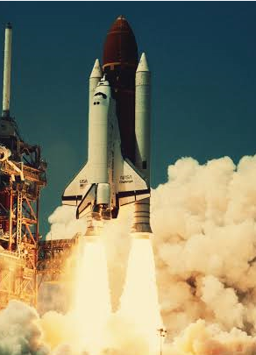
Covered concept:
Relationship between linear momentum conservation and Newton’s third law
Rocket moving into space

Slide 5
Rocket propulsion is a good example that explains the relationship between the Newton’s third law and the law of conservation of momentum.
The system of a rocket has a varying mass with lime.
In a rocket, the combustion of fuels at high temperature and pressure generates gasses that are ejected from a nozzles, the escaping gasses creates a reaction that provides thrust enough to launch and flight a rocket.
Using the law of conservation of momentum, the escaping gasses are equal to the momentum gained by the rocket.
Consequently, the fuel system and the mass of the rocket keeps on falling due to absconding mass of gases.

Slide 6
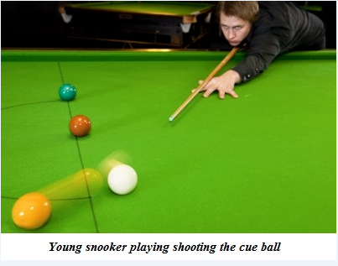
Covered concept:
How momentum conservation is exemplified in various physical activities.
Momentum before collision = momentum after collision.

Slide 7
Observed: before and after the collision, the white ball hits the yellow ball it losses momentum and the yellow ball gains momentum. The amount of momentum lost by the white ball is equal to the amount of momentum gained by the yellow ball.
Explanation: from the law of conservation of linear momentum which states that the momentum remains unchanged no matter what until an external force comes into action with it.
Mathematically, the conservation of momentum is as a result of homogeneity of space meaning the physical laws are not dependent on the position.
For example, when the before the white ball is hit, its position is zero since its at rest, when it collides with the yellow ball, at the end the yellow ball is at rest and therefore both initial and final momentum should be zero according to the law of conservation of momentum. i.e. F1 = -F2 and F1 + F2 = 0

Slide 8
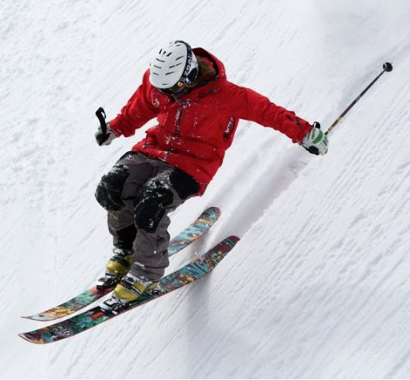

Covered concept:
Difference between kinetic and potential energy.
Kinetic Energy (A)
Potential Energy (B)

Slide 9
Observed: Picture A shows a skier (mass) in motion (velocity) showing kinetic energy while picture B, is a bowl with an arrow which has not been released yet showing potential energy.
Explanation: Kinetic energy can be defined as the energy present in the object due to motion, on the other hand, potential energy is the energy obtained from the object from its stationary position.
Kinetic energy can be transferred between objects while potential energy cannot be transferred to other objects.
The kinetic energy is measured from its current position while potential energy is measured from the bottom.
The kinetic energy can be calculated by using the mass of an object in motion while potential energy is calculated using the assertion of mass, height and gravity.

Slide 10
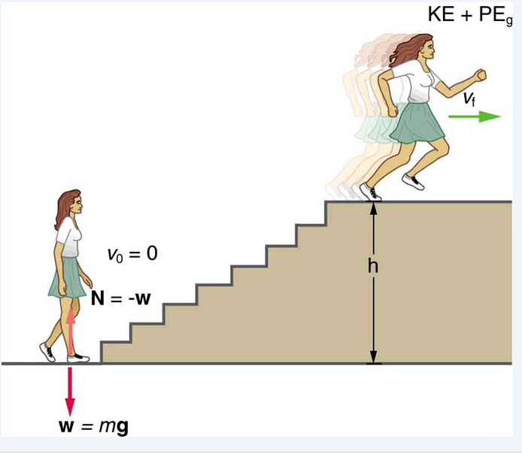
Covered concept:
The relation among work, energy and power in daily life
N = -w
W = mg
W = 0 at the bottom of stairs since both KE and PE are at zero initially
W = KE + PE
W = Work
m = mass
g = gravity
KE = Kinetic Energy
PE = Potential Energy
N = Force

Slide 11
Observed: The woman uses energy to climb up the stairs which is converted into power meaning work is done.
Explanation: When the woman is walking or climbing up the stairs assuming she starts from rest, the chemical energy generated from food is converted into gravitational potential energy and kinetic energy, Her power output depends about how fast she moves.
Food Energy (0E_{i}) = Work energy (W_{nc}) + (Thermal Energy + Stored fat).
Power is an implication that shows energy has been transferred or has changed or is changing its form.
Transfer of energy can be used to do work and power can be attributed to the rate at which work is done.
The work converted into mechanical energy is W = KE + PE

Slide 12
References
Giancoli, D. C (2013). Physics: Principles with applications. Pearson Higher Ed.
Knight R.D. (2017) Physics for scientists and engineers. Pearson Higher Ed.

